Slide 1
Computer Architecture Experiment
Topic 4. Pipelined CPU with Cache
浙江大学计算机学院
2021年9月

Slide 2
Outline
Experiment Purpose
Experiment Task
Basic Principle
Operating Procedures
Checkpoints

Slide 3
Experiment Purpose
Understand the principle of Cache Management Unit (CMU) and State Machine of CMU
Master the design methods of CMU and Integrate it to the CPU.
Master verification methods of CMU and compare the performance of CPU when it has cache or not.

Slide 4
Experiment Task
Design of Cache Management Unit and integrate it to CPU.
Observe and Analyze the Waveform of Simulation.
Compare the performance of CPU when it has cache or not.

Slide 6
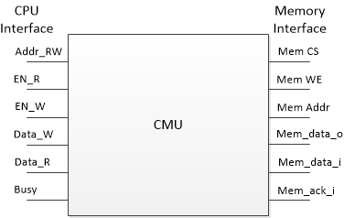
Cache Management Unit

Slide 7
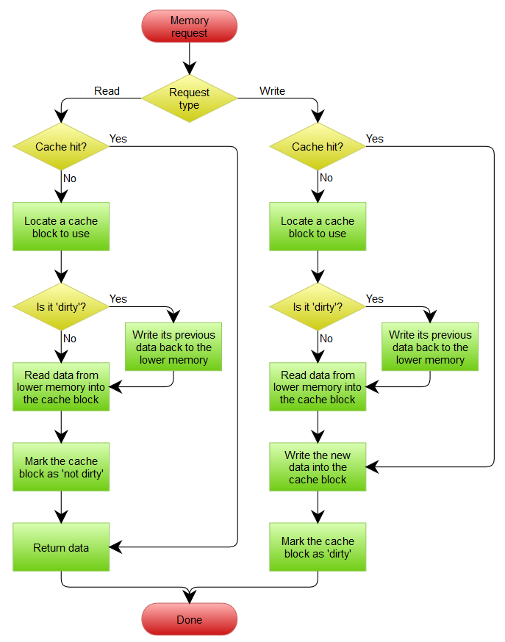
Cache Operation Flow
Read (Hit/Miss)
Write (Hit/Miss)
Replace (Clean/Dirty)

Slide 8
Cache Management State Machine
Notes:
cache操作均发生在当前state的下降沿，memory操作均发生在当前state的上升沿。
S_IDLE：空闲状态，不进行memory操作，cache操作hit的情况下一直处于这个状态。
S_PRE_BACK：为了写回，先进行一次读cache。
S_BACK：上升沿将上个状态的数据写回到memory，下降沿从cache读下次需要写回的数据（因此最后一次读无意义），由计数器控制直到整个cache line全部写回。由于memory设置为4个周期完成读写操作，因此需要等待memory给出ack信号，才能进行状态的改变。
S_FILL：上升沿从memory读取数据，下降沿向cache写入数据，由计数器控制直到整个cache line全部写入。与S_BACK类似，需要等待ack信号。
S_WAIT：执行之前由于miss而不能进行的cache操作。

Slide 9
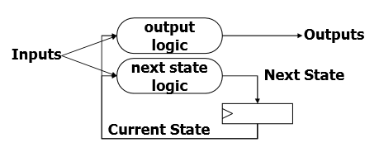
State Machine
Next State Logic
State assignment
Output

Slide 10
Next logic (1)
S_IDLE: begin
if (en_r || en_w) begin
if (cache_hit)
next_state = ???;
else if (cache_valid && cache_dirty)
next_state = ???;
else
next_state = ???;
end
next_word_count = 2'b00;
end
S_PRE_BACK: begin
next_state = ???;
next_word_count = 2'b00;
end
Notes:
S_IDLE: begin
if (en_r || en_w) begin
if (cache_hit)
next_state = S_IDLE;
else if (cache_valid && cache_dirty)
next_state = S_PRE_BACK;
else
next_state = S_FILL;
end
next_word_count = 2'b00;
end
S_PRE_BACK: begin
next_state = S_BACK;
next_word_count = 2'b00;
end

Slide 11
Next logic (2)
S_BACK: begin
if (mem_ack_i && word_count == {ELEMENT_WORDS_WIDTH{1'b1}}) // 2'b11 in default case
next_state = ???;
else
next_state = ???;
if (mem_ack_i)
next_word_count = ???;
else
next_word_count = word_count;
end
Notes:
S_BACK: begin
if (mem_ack_i && word_count == {ELEMENT_WORDS_WIDTH{1'b1}}) // 2'b11 in default case
next_state = S_FILL;
else
next_state = S_BACK;
if (mem_ack_i)
next_word_count = word_count + 2'b01;
else
next_word_count = word_count;
end

Slide 12
Next logic (3)
S_FILL: begin
if (mem_ack_i && word_count == {ELEMENT_WORDS_WIDTH{1'b1}})
next_state = ???;
else
next_state = ???;
if (mem_ack_i)
next_word_count = ???;
else
next_word_count = word_count;
end
S_WAIT: begin
next_state = ???;
next_word_count = 2'b00;
end
Notes:
S_FILL: begin
if (mem_ack_i && word_count == {ELEMENT_WORDS_WIDTH{1'b1}})
next_state = S_WAIT;
else
next_state = S_FILL;
if (mem_ack_i)
next_word_count = word_count + 2'b01;
else
next_word_count = word_count;
end
S_WAIT: begin
next_state = S_IDLE;
next_word_count = 2'b00;
end

Slide 13
Perform State Assignment
always @ (posedge clk) begin
if (rst) begin
state <= S_IDLE;
word_count <= 2'b00;
end
else begin
state <= next_state;
word_count <= next_word_count;
end
end

Slide 14
Output (1)
case(state)
S_IDLE, S_WAIT: begin
cache_addr = addr_rw;
cache_load = en_r;
cache_edit = en_w;
cache_store = 1'b0;
cache_u_b_h_w = u_b_h_w;
cache_din = data_w;
end
S_BACK, S_PRE_BACK: begin
cache_addr = {addr_rw[ADDR_BITS-1:BLOCK_WIDTH], next_word_count, {ELEMENT_WORDS_WIDTH{1'b0}}};
cache_load = 1'b0;
cache_edit = 1'b0;
cache_store = 1'b0;
cache_u_b_h_w = 3'b010;
cache_din = 32'b0;
end
S_FILL: begin
cache_addr = {addr_rw[ADDR_BITS-1:BLOCK_WIDTH], word_count, {ELEMENT_WORDS_WIDTH{1'b0}}};
cache_load = 1'b0;
cache_edit = 1'b0;
cache_store = mem_ack_i;
cache_u_b_h_w = 3'b010;
cache_din = mem_data_i;
end
endcase

Slide 15
Output (2)
case (next_state)
S_IDLE, S_PRE_BACK, S_WAIT: begin
mem_cs_o = 1'b0;
mem_we_o = 1'b0;
mem_addr_o = 32'b0;
end
S_BACK: begin
mem_cs_o = 1'b1;
mem_we_o = 1'b1;
mem_addr_o = {cache_tag, addr_rw[ADDR_BITS-TAG_BITS-1:BLOCK_WIDTH], next_word_count, {ELEMENT_WORDS_WIDTH{1'b0}}};
end
S_FILL: begin
mem_cs_o = 1'b1;
mem_we_o = 1'b0;
mem_addr_o = {addr_rw[ADDR_BITS-1:BLOCK_WIDTH], next_word_count, {ELEMENT_WORDS_WIDTH{1'b0}}};
end
endcase

Slide 16
RV32 Core
module cmu (
input clk, // CPU side
input rst,
input [31:0] addr_rw,
input en_r,
input en_w,
input [2:0] u_b_h_w,
input [31:0] data_w,
output [31:0] data_r,
output stall,
output reg mem_cs_o = 0, // mem side
output reg mem_we_o = 0,
output reg [31:0] mem_addr_o = 0,
input [31:0] mem_data_i,
output [31:0] mem_data_o,
input mem_ack_i,
output [2:0] cmu_state // debug info
);

Slide 17
Instr. Mem.(1)
NO. | Instruction | Addr. | Label | ASM | Comment
0 | 00000013 | 0 | __start: | addi x0, x0, 0
1 | 01c00083 | 4 |  | lb x1, 0x01C(x0) | # F0F0F0F0 in 0x1C # FFFFFFF0 miss, read 0x010~0x01C to set 1 line 0
2 | 01c01103 | 8 |  | lh x2, 0x01C(x0) | # FFFFF0F0 hit
3 | 01c02183 | C |  | lw x3, 0x01C(x0) | # F0F0F0F0 hit
4 | 01c04203 | 10 |  | lbu x4, 0x01C(x0) | # 000000F0 hit
5 | 01c05283 | 14 |  | lhu x5, 0x01C(x0) | # 0000F0F0 hit
6 | 21002003 | 18 |  | lw x0, 0x210(x0) | # miss, read 0x210~0x21C to cache set 1 line 1
7 | abcde0b7 | 1C |  | lw x7, 20(x0)
8 | 402200b3 | 20 |  | lui x1 0xABCDE
9 | 71c08093 | 24 |  | addi x1, x1, 0x71C | # x1 = 0xABCDE71C
10 | 00100023 | 28 |  | sb x1, 0x0(x0) | # miss, read 0x000~0x00C to cache set 0 line 0
11 | 00101223 | 2C |  | sh x1, 0x4(x0) | # hit
12 | 00102423 | 30 |  | sw x1, 0x8(x0) | # hit

Slide 18
Instr. Mem.(2)
NO. | Instruction | Addr. | Label | ASM | Comment
13 | 20002303 | 34 |  | lw x6, 0x200(x0) | # miss, read 0x200~0x20C to cache set 0 line 1
14 | 40002383 | 38 |  | lw x7, 0x400(x0) | # miss, write 0x000~0x00C back to ram, then read 0x400~40C to cache set 0 line 0
15 | 41002403 | 3C |  | lw x8, 0x410(x0) | # miss, no write back because of clean, read 0x410~41C to chache set 1 line 0
16 | 0ed06813 | 40 | loop: | lori x16, x0, 0xED | # end
17 | ffdff06f | 44 |  | jal x0, loop

Slide 19
Data Mem.
NO. | Data | Addr. | Comment
0 | 000080BF | 0
1 | 00000008 | 4
2 | 00000010 | 8
3 | 00000014 | C
4 | FFFF0000 | 10
5 | 0FFF0000 | 14
6 | FF000F0F | 18
7 | F0F0F0F0 | 1C
8 | 00000000 | 20
9 | 00000000 | 24
10 | 00000000 | 28
11 | 00000000 | 2C
12 | 00000000 | 30
13 | 00000000 | 34
14 | 00000000 | 38
15 | 00000000 | 3C
NO. | Instruction | Addr. | Comment
16 | 00000000 | 40
17 | 00000000 | 44
18 | 00000000 | 48
19 | 00000000 | 4C
20 | A3000000 | 50
21 | 27000000 | 54
22 | 79000000 | 58
23 | 15100000 | 5C
24 | 00000000 | 60
25 | 00000000 | 64
26 | 00000000 | 68
27 | 00000000 | 6C
28 | 00000000 | 70
29 | 00000000 | 74
30 | 00000000 | 78
31 | 00000000 | 7C

Slide 20
Test Bench
initial begin
data[0] = 40'h0_2_00000004; // read miss 1+17
data[1] = 40'h0_3_00000019; // write miss 1+17
data[2] = 40'h1_2_00000008; // read hit 1
data[3] = 40'h1_3_00000014; // write hit 1
data[4] = 40'h2_2_00000204; // read miss 1+17
data[5] = 40'h2_3_00000218; // write miss 1+17
data[6] = 40'h0_3_00000208; // write hit 1
data[7] = 40'h4_2_00000414; // read miss + dirty 1+17+17
data[8] = 40'h1_3_00000404; // write miss + clean 1+17
data[9] = 40'h0; // end total: 128
end

Slide 21
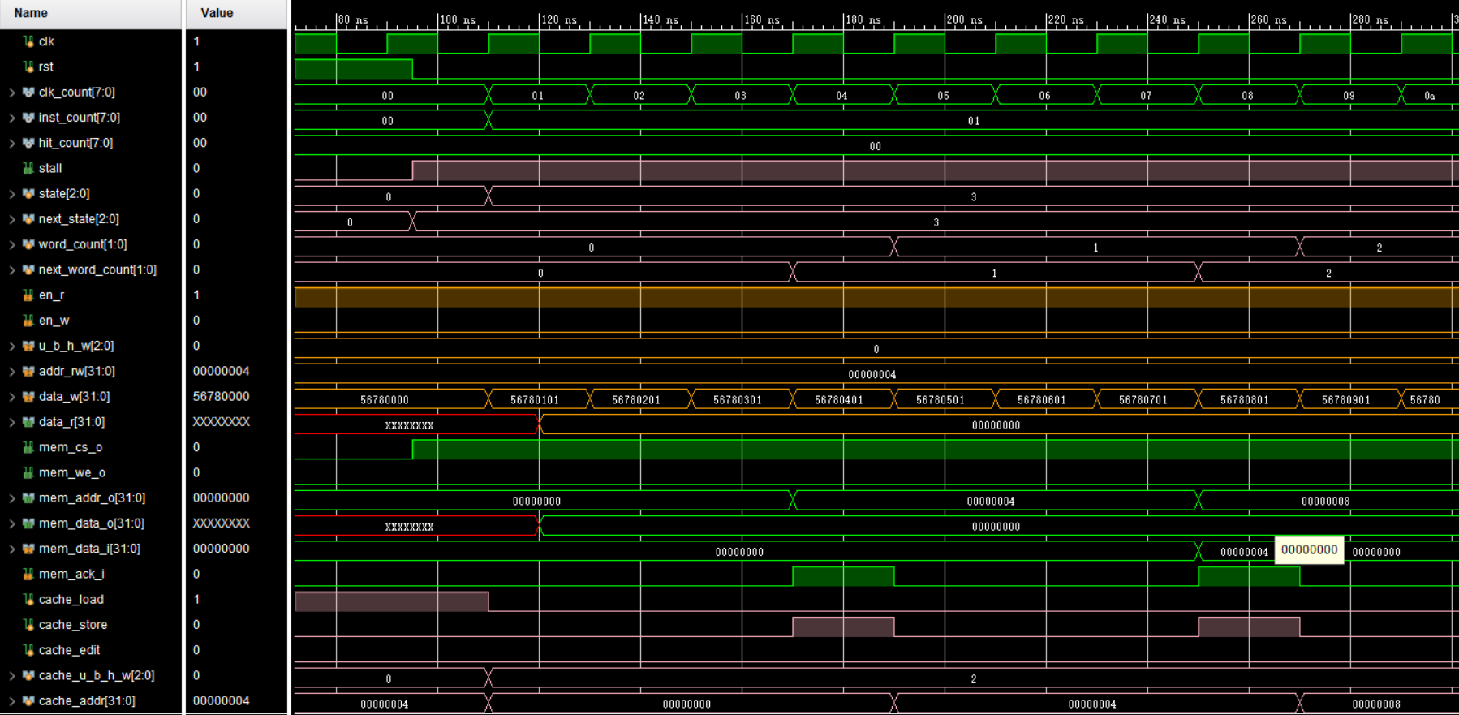
Simulation(1)

Slide 22
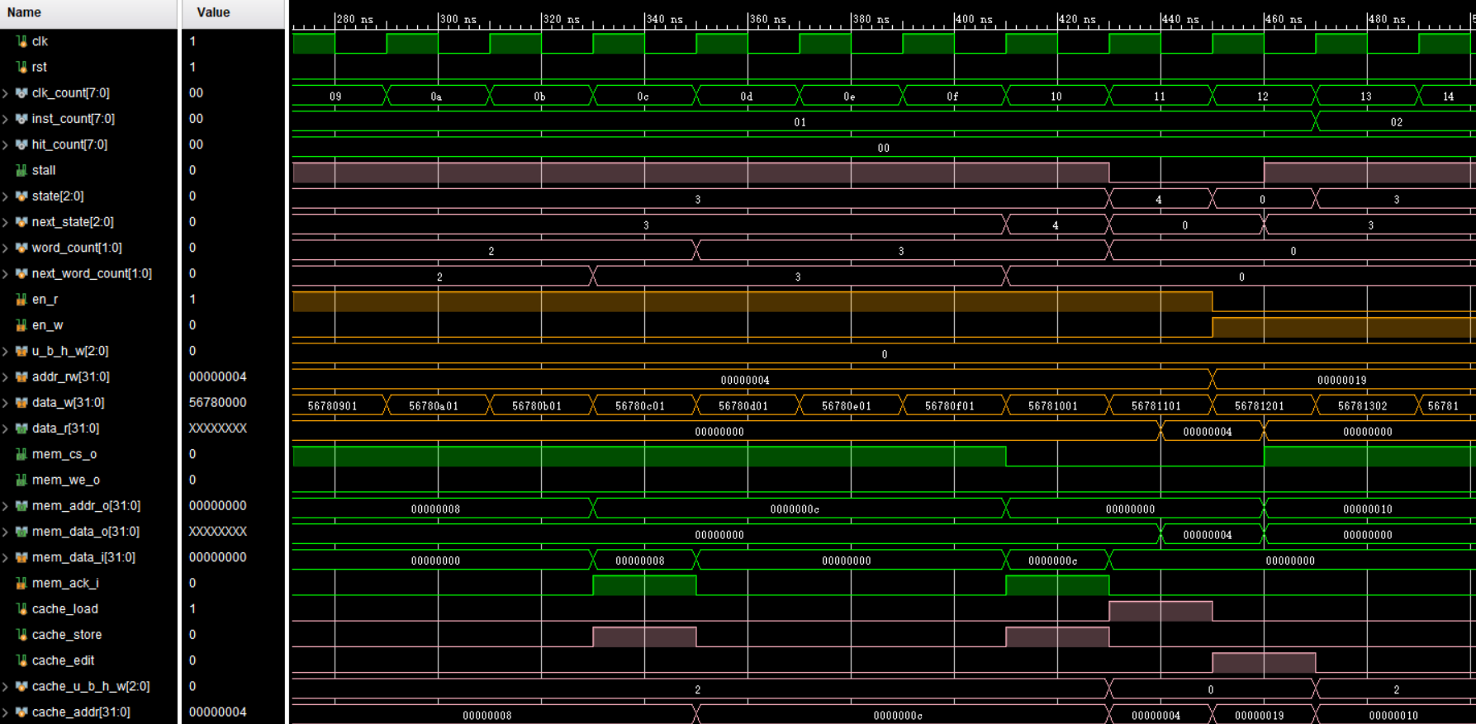
Simulation(2)

Slide 23
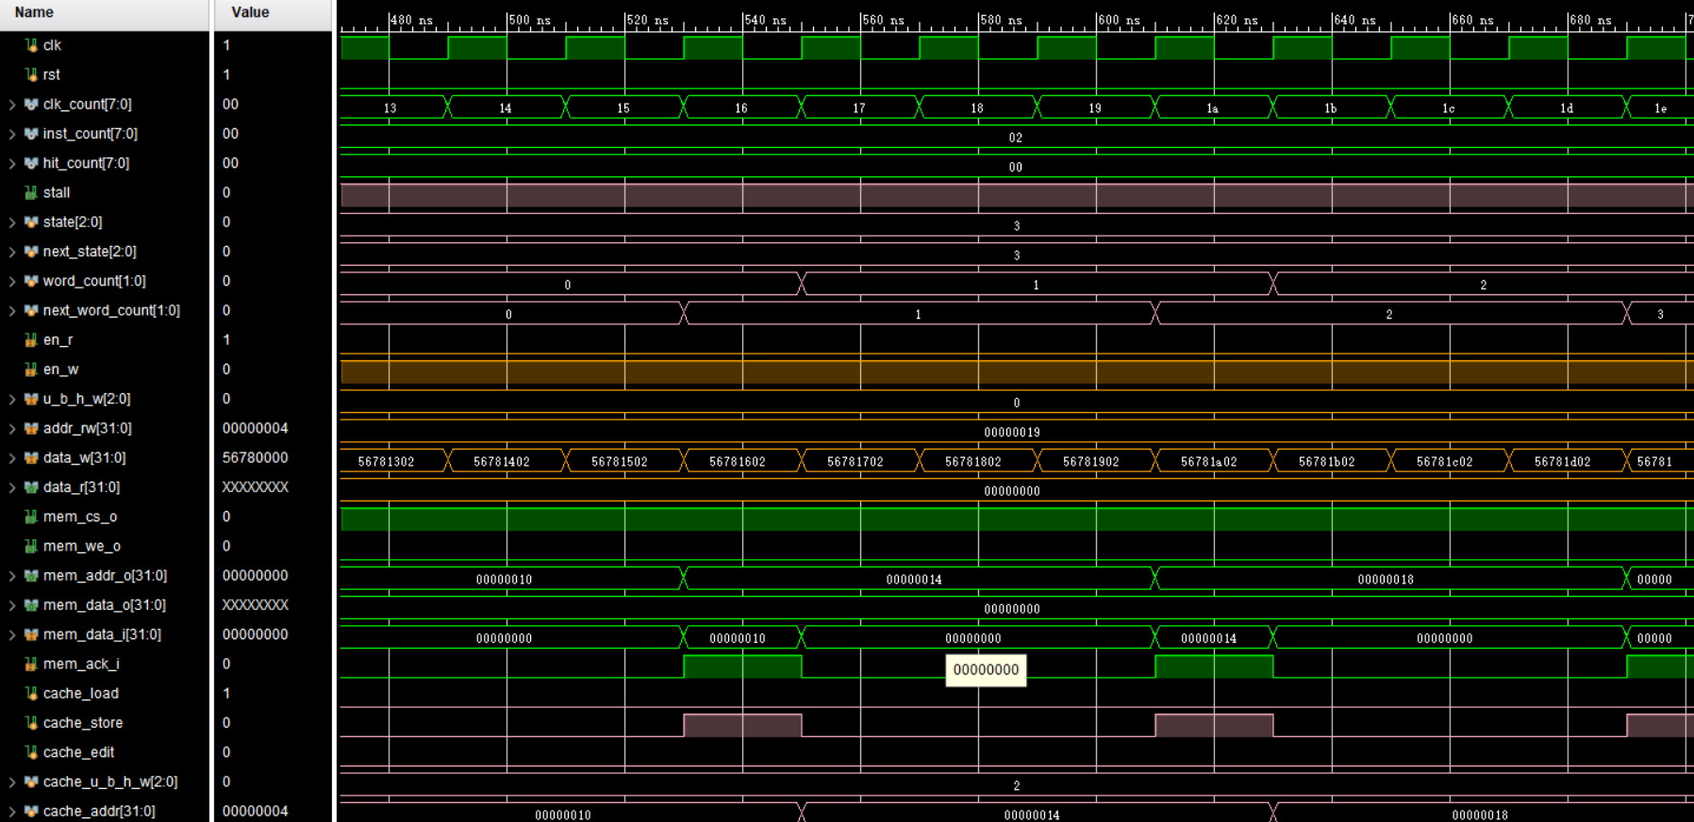
Simulation(3)

Slide 24
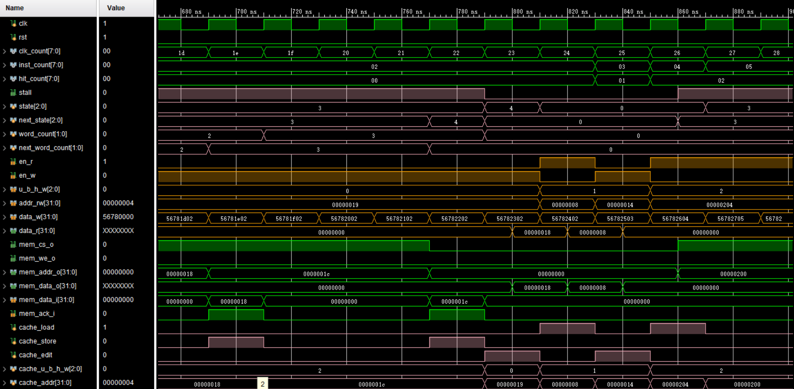
Simulation(4)

Slide 25
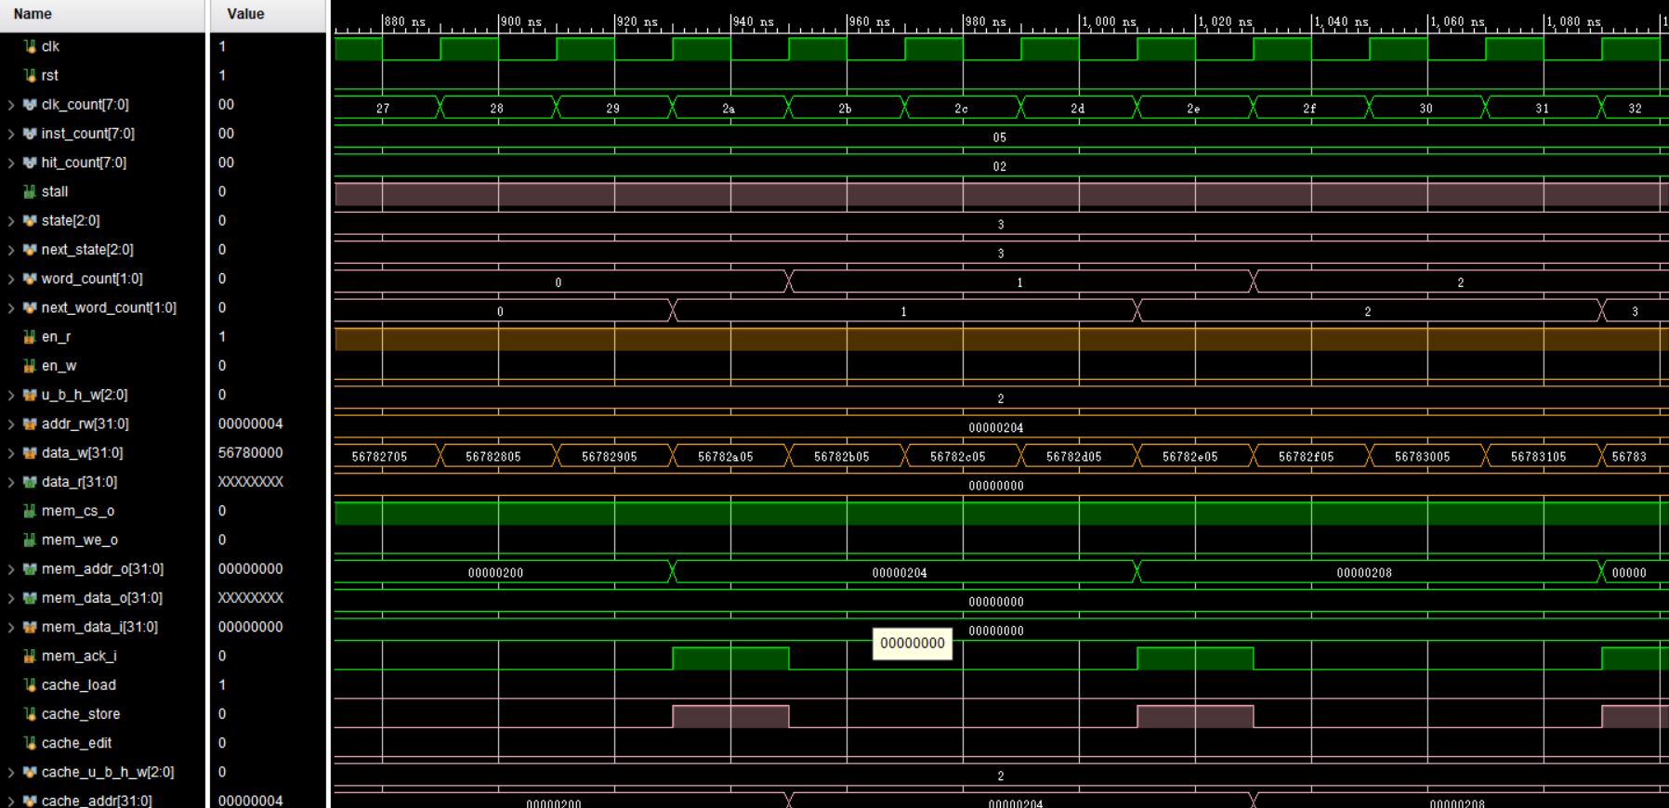
Simulation(5)

Slide 26
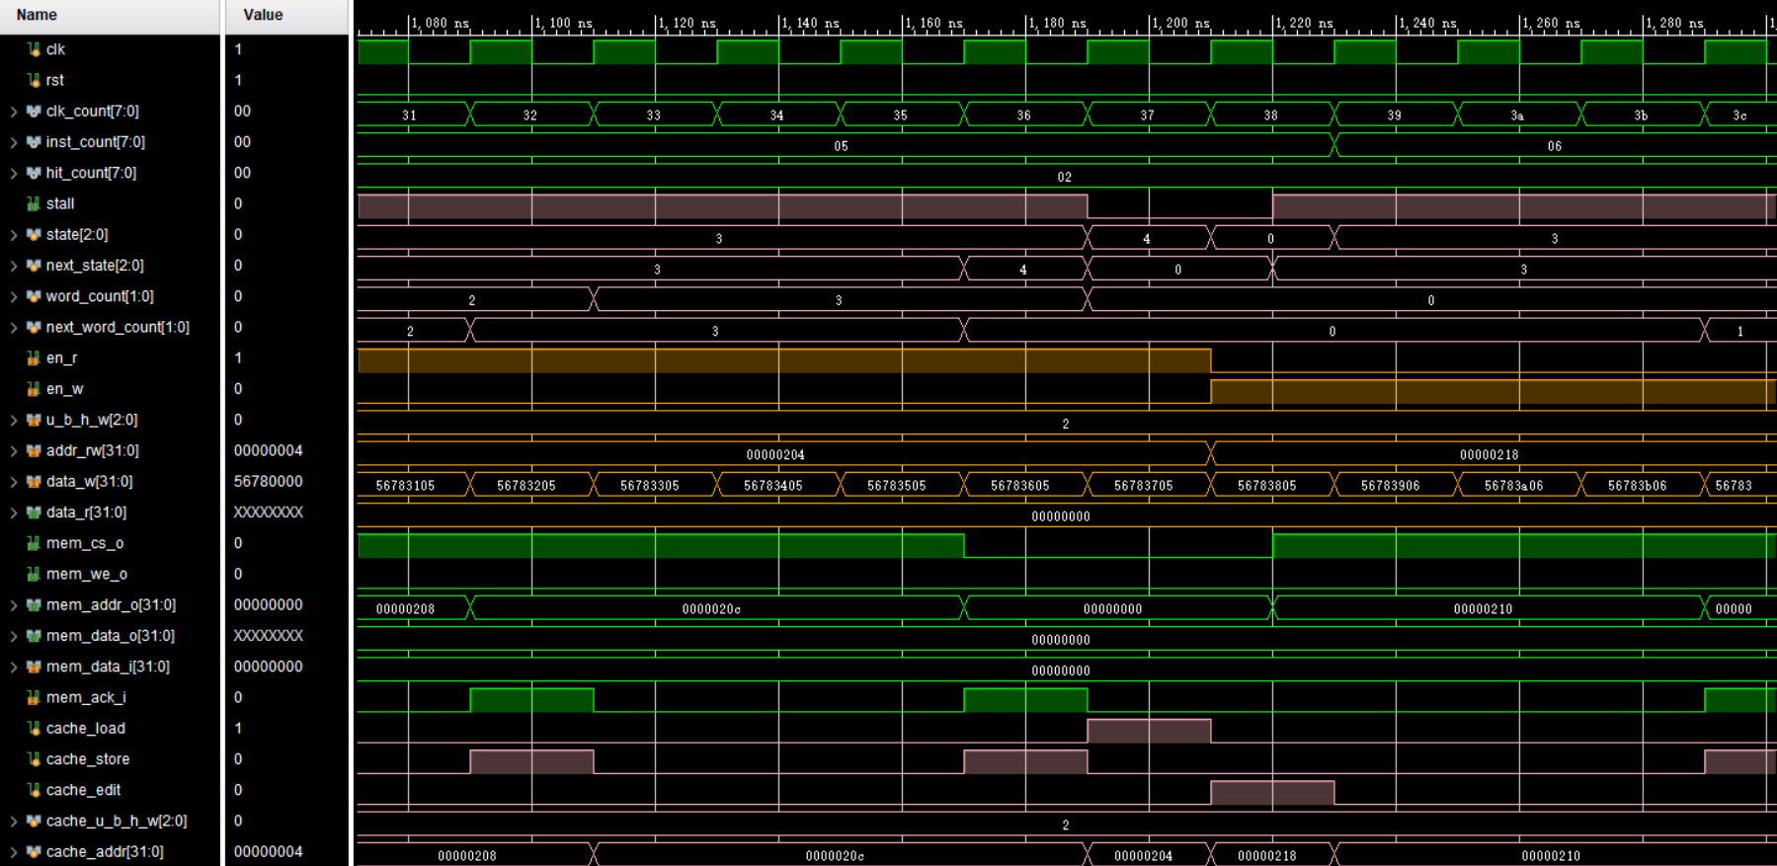
Simulation(6)

Slide 27
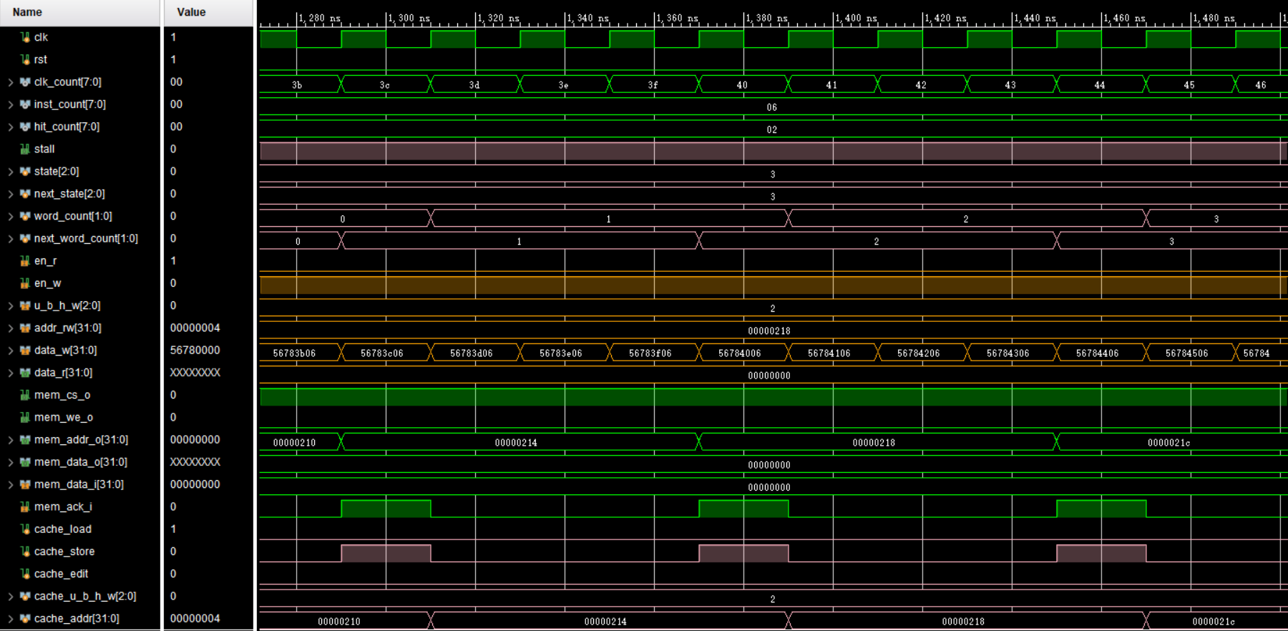
Simulation(7)

Slide 28
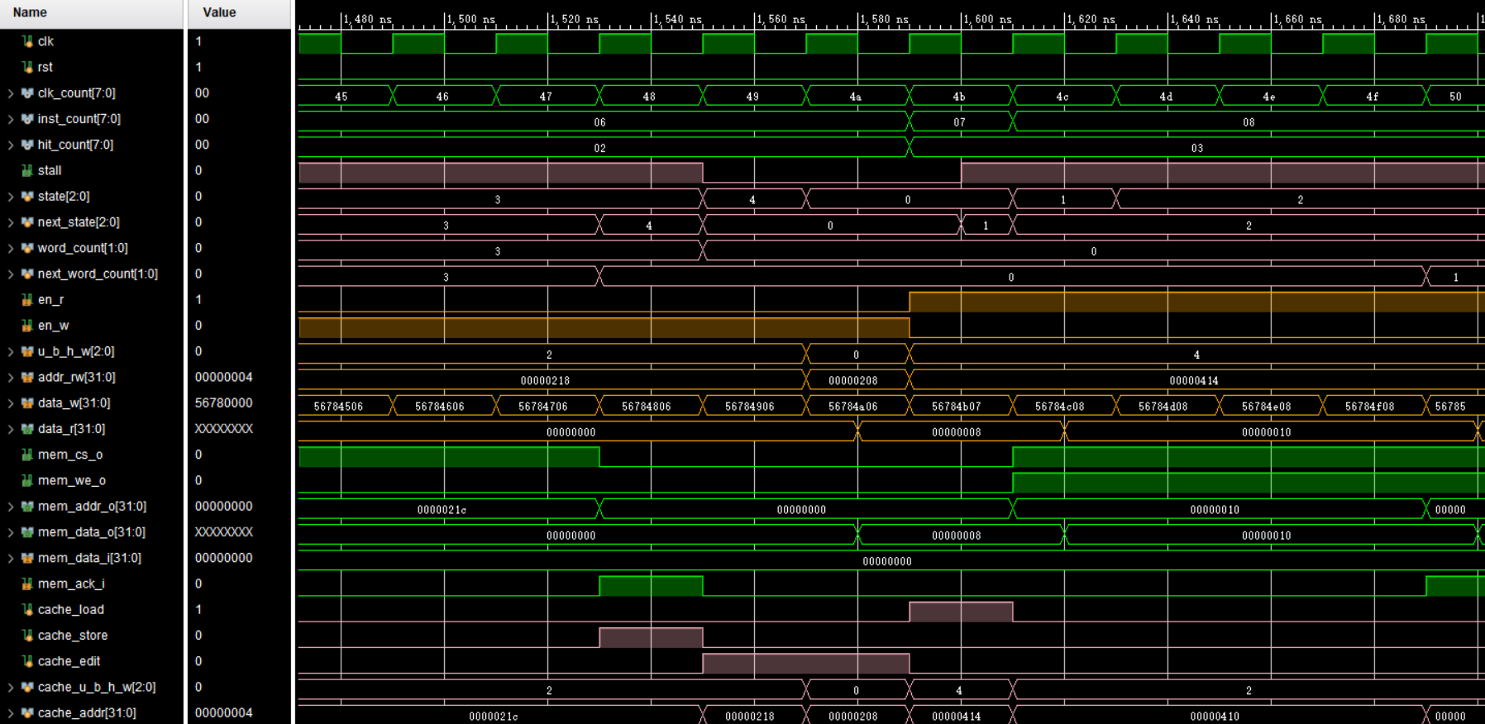
Simulation(8)

Slide 29
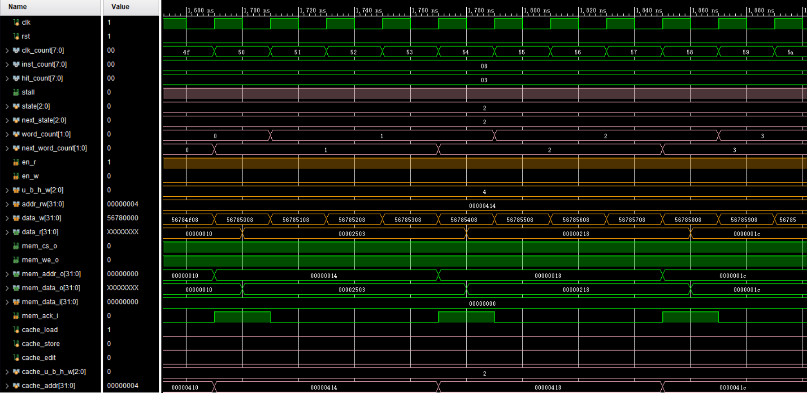
Simulation(9)

Slide 30
Checkpoints
CP1:
Waveform Simulation of CMU.
CP2:
FPGA Verification.

Slide 31
Thanks!

